Slide 1
Chapter Nine Developing Teamwork
LEADERSHIP
Andrew J. DuBrin, 7th Edition
Course Instructor : Ms. Rizwana Hameed

Slide 2
Learning Objectives
Understand the leader’s role in a team-based organization.
Describe leader actions that foster teamwork.
Explain the potential contribution of outdoor training to the development of team leadership.
Describe how the leader-member exchange model contributes to an understanding of leadership.

Slide 3
Teams and Teamwork
Team
Work group that must rely on collaboration of each member to experience optimum success and achievement.
Teamwork
Work down with an understanding and commitment to group goals on the part of all team members.
Developing teamwork is such an important leadership role that team building is said to differentiate successful from unsuccessful leaders.

Slide 4
Distinguishing Between Teams and Groups
Teams
Groups
Characterized by a common commitment
Shared leadership roles
Accomplishes many collective work products
Includes individual & mutual accountability
Produce collective work product
Team leader encourages open-ended discussions and active problem-solving
Team members discuss, decide, and do real work together
May not have a strong commitment
Members tend to work slightly more independently
Members have a strong leader
Emphasizes individual accountability
Sometimes produce individual work products
Group leader runs an efficient meeting
More likely to discuss, divide, and delegate

Slide 5
The Leader’s Role in the Team-Based Organization
Team-based organizations need leaders who are knowledgeable in the team process and can help with the interpersonal demands of teams.
Key roles of a team-based leader:
Building trust and inspiring teamwork
Coaching team members and group members toward higher levels of performance
Facilitating and supporting the team’s decisions
Expanding the team’s capabilities
Creating a team identity
Anticipating and influencing change
Inspiring the team toward higher levels of performance
Enabling and empowering group members to accomplish their work
Encouraging team members to eliminate low-value work

Slide 6
Fostering Teamwork
Leader’s Personality
Inspiring, Charm, Charisma, Personal Magnetism
Informal Techniques
Using the Leader’s Resources
Formal Techniques
Requires Organizational Structures and Policies

Slide 7
Teamwork Actions Leaders Can Take Using Their Own Resources
Defining team mission
Establishing a climate of trust
Develop a norm of teamwork, including emotional intelligence
Emphasize pride in being outstanding
Serve as a model of teamwork, including power sharing
Use a consensus leadership style
Establish urgency, demand performance standards, and provide direction
Encourage cooperation with another group
Encourage use of jargon
Minimize micro managing
Practice e-leadership for virtual teams

Slide 8
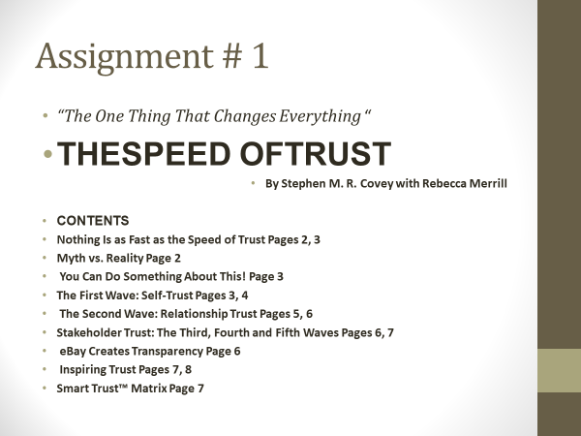

Slide 9
Teamwork Actions Generally Requiring Organization Structure or Policy
Designing physical structures that facilitate communication
Emphasizing group recognition and rewards
Initiating ritual and ceremony
Practicing open-book management
Selecting team-oriented members
Using technology that facilitates teamwork including social media
Blending representatives from the domestic company and foreign nationals on the team

Slide 10
Offsite Training & Team Development—Outdoor Training
Participation in experiential activities aimed at building teamwork and leadership skills
Participants acquire leadership and teamwork skills by confronting physical challenges and exceeding their self-imposed limitations.
Emphasis is typically on building not only teamwork but also self-confidence for leadership.
Outdoor training enhances teamwork by helping participants examine the process of getting things done through working with people.

Slide 11
Offsite Training & Team Development—Outdoor Training
Pros:
Perception that trust, cooperation, communication, self-confidence, and teamwork improve with outdoor training.
Cons:
Perception that team members revert to old behaviors over time, team members come and go, thereby diluting the experience for their group, and team members are sometimes exposed to harm or injury.

Slide 12
Group Tasks
Perhaps the most widely used team-building activity is the trust fall, which may be familiar to many readers. Nevertheless, each application of this exercise is likely to produce new and informative results. The class organizes itself into teams. In each team, each willing member stands on a chair and falls back into the arms of teammates. A less frightening alternative to falling off a chair is to simply fall backward standing up. Team members who, for whatever physical or mental reason, would prefer not to fall back into others or participate in catching others are unconditionally excluded. However, they can serve as observers. After the trust falls have been completed, a team leader gathers answers to the following questions and then shares the answers with the rest of the class.
1.How does this exercise develop teamwork?
2.How does the exercise develop leadership skills?
3.What did the participants learn about themselves?

Slide 13
Thank you

